Slide 1
Wabash Capstone
Project Notes 03
By: John Danison

Slide 2

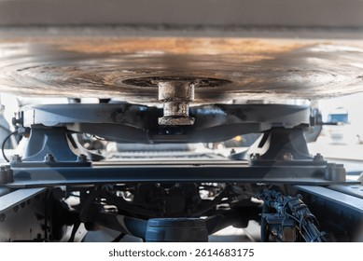
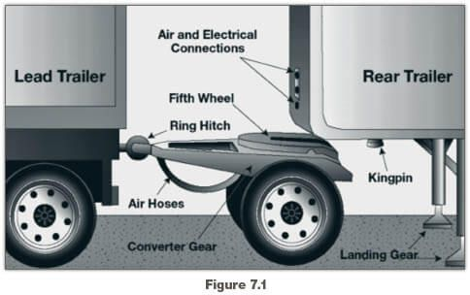
What Have I Done This Week
Researched further into Kingpin & Couplers
Scheduled a Time to Meet For GR1.5
Wrote Gate Report 1

Slide 3
Did I Do What I Say I Would Do?
Yes, I feel that I met my promises this past week. There is nothing outstanding where I am holding my group back from making progress.
I have attended every class so far. I continue to lead the EE & DAQ of this project.

Slide 4
Plans For Upcoming Week
Continue To:
Refine Sensors, Power Systems, & Data Acquisition Strategies
Communicate with Team Members
By EOW:
Present GR1.5
Acquire More Information From Wabash

